Slide 1

Forecasting Land Prices in Colombo District
DSC4996 – Final Presentation
26/02/2024
Supervisor: Prof. Roshan D. Yapa
With the supervision of the company :
W.G.K.D Weerasinghe
S/17/509

Slide 2
Table of contents
01
02
03
04
05
06
Introduction to the project
Literature Review
Methodology
Results & Discussion
Conclusion & Future Works
Acknowledgement

Slide 3
01
Introduction to the project

Slide 4
01. Introduction to the project
Problem Statement
Urban development in Sri Lanka, especially in Colombo, drives a dynamic real estate market with fluctuating land prices.
Opportunities and challenges exist for stakeholders: investors, developers, policymakers, and the public.
Colombo District, the commercial hub, plays a pivotal role in real estate evolution due to its strategic location.
Growing demand for land raises concerns about sustainability, necessitating informed decision-making in the real estate sector.

Slide 5
01. Introduction to the project
Impact
Collaboration with "Lanka Property Web" is crucial for effective planning, investment analysis, and policy development.
Leveraging data and expertise from Lanka Property Web for real-time insights into market dynamics.
Significance extends beyond real estate, impacting economic stability, urban development, investor confidence, socioeconomic equity, and market transparency.
Accurate predictions influence investment decisions, revenue projections, and budget planning for sustainable growth in the Colombo District.

Slide 6
01. Introduction to the project
Objectives
Build a Land Value Prediction Model that predicts land prices when customers enter their land details.
Develop a time series model to predict the land prices in each city within the Colombo District in next few years.

Slide 7
02
Literature Review

Slide 8
02. Literature Review
Silva, Shanaka & Karunarathna, MPGGL. (2016). Extrapolating a Sri Lankan Real Estate Price Index: Background Analysis.
Objective: Explore diverse methods for constructing a Property Price Index (PPI).
Methods: Simple Mean/Median, Stratification, Repeat Sales, Appraisal-Based, and Hedonic Regression are examined.
Hedonic Regression: Widely accepted, this method estimates implicit prices for various housing attributes through regression analysis.
Attributes Considered: Locational, structural, and neighborhood factors, such as CBD distance, rooms, crime rates, and amenities, impact property values.
Conclusion: Hedonic Regression stands out as the preferred approach, providing a comprehensive understanding of attribute contributions to property prices.

Slide 9
02. Literature Review
Sampathkumar, V. & Santhi, M. & Vanjinathan, J.. (2015). Forecasting the Land Price Using Statistical and Neural Network Software. Procedia Computer Science. 57. 112-121. 10.1016/j.procs.2015.07.377.
Objective: Model and forecast land prices using regression and neural networks.
Methods: Regression analyzes variables; a five-layered neural network forecasts with Levenberg-Marquardt.
Neural Network Superiority: Neural network is more accurate, proving effectiveness of architecture and algorithm.
Model Evaluation Metrics: Evaluation with Chi-square, MAPE, and PRMSE favors ANN over regression.
Conclusion: Factors like silver price, population, and economic indicators influence land prices. Combination of 8% home loan, 6% inflation, and 10% GDP controls prices, reducing up to 4%.

Slide 10
02. Literature Review
Sundari, S.N; Devi, R.R; Subasri I. (2020). Land Price Prediction using Artificial Intelligence. International Research Journal of Engineering and Technology (IRJET), 7(4), 4422–4425.
Objective: Introduce HMM, NLP, SVM, ANNs, and Back Propagation Algorithm.
Methods: Explain statistical modeling, multidisciplinary focus, hyperplane separation, ANN architecture, and Back Propagation.
Statistical Models and Classifiers Overview: Overview of HMM, NLP, and SVM.
Neural Networks in Land Valuation: Application and significance of ANNs in land valuation.
Conclusion: Emphasize the importance of these models in diverse applications.

Slide 11
02. Literature Review
Dwi Kisworini, I. . (2022). LAND VALUE PREDICTION MODEL IN THE URBAN FRINGE REGION USING MULTIPLE REGRESSION ALGORITHM. Journal of Marine-Earth Science and Technology, 2(3), 28–33. https://doi.org/10.12962/j27745449.v2i3.442
Objective: Predict land prices in Urban Fringe without additional variables.
Methods: Use regression analysis with transaction and bid prices, incorporating physical attributes, environmental conditions, and ownership status.
Urban Fringe Land Price Prediction Methods: Focus on swift development in Gununganyar, driven by housing demand, and use methods like market data comparison, cost approach, and income approach for property valuation.
Regression Analysis for Land Values: Predict land values in Gununganyar using multiple linear regression, identify insignificant variables, achieve R2 of 82.5% impact through hypothesis tests.
Conclusion: Mass appraisal with multiple regression is precise for predicting land values in rapidly transforming areas

Slide 12
03
Methodology

Slide 13
03. Methodology
Data Collection
Source of Data: Provided by Lanka Property Web.
Nature of Data: Customer-submitted data about lands advertised for sale on LPW.
Geographical Scope: Limited to the Colombo district.
Time Frame: Data collected from January 2018 to September 2023.
Dataset Details:
Initial dataset with 185 columns.
Comprehensive information about lands, including location, price, size, shape, Geo coordinates, and address details.
High occurrence of null values in the columns.
Combined dataset includes 58,352 entries, incorporating customer data from the ads.
Focus Area: Research considers approximately 50 main cities within the Colombo district.

Slide 14
03. Methodology
Data Cleaning
Focus on Bare Lands: Utilized bare lands data exclusively, consisting of about 51,000 rows.
Handling Null Values: Identified and removed over 100 columns with entirely null values. Eliminated some additional unwanted columns based on company advice.
Column Standardization: Standardized city names for consistency in the dataset.
Price Per Unit Area: Since Land price per peach is the main thing to consider, I introduced a new column for the price per unit area for all data rows.
Zero-Value Price Removal: Removed entries with a price value of 0.
Outlier Handling: Applied the interquartile range to filter out outlier prices.
Resulting Dataset: After cleaning, retained 27,000+ rows and 21 columns.

Slide 15
03. Methodology
Exploratory Data Analysis
Average Land Price Analysis:
Calculated the overall average land price.
Further analyzed the average land price on a year-wise basis from 2018 to 2023.
Time Series Analysis:
Conducted time series analysis for each city individually.
Explored temporal patterns and trends in land prices over the specified period.
City-wise Comparison:
Investigated variations in land prices among different cities.
Identified cities with notable price fluctuations and trends.

Slide 16
03. Methodology
Spatial Network Analysis
Geospatial Data Points:
Utilized data points with exact geographical coordinates.
Distance Calculation:
Calculated distances from each land location to specific points of interest, such as schools, hospitals, railway station and main road.
Spatial Network Analysis:
Conducted spatial network analysis to understand the relationships and connectivity between land locations and key amenities.

Slide 17
03. Methodology
Machine Learning
Multiple Linear Regression
Extension of linear regression to model the relationship between a dependent variable and two or more independent variables using a linear equation.
Y = β₀ + β₁X₁ + β₂X₂ + ... + βₖXₖ + ε
Y: Dependent variable | X₁, X₂, ..., Xₖ: Independent variables | β₀: Intercept
β₁, β₂, ..., βₖ: Coefficients for each independent variable | ε: Error term
Assumptions: Similar to simple linear regression with additional assumption of no multicollinearity between independent variables.

Slide 18
03. Methodology
Machine Learning
Random Forest Regressor
Ensemble learning method based on decision trees, creating a robust predictor by aggregating multiple decision trees. It builds numerous trees using random subsets of features and data and averages their predictions for improved accuracy.
Limitations:
Lack of interpretability.
Computationally intensive for large datasets.
May struggle with highly correlated features.

Slide 19
03. Methodology
Machine Learning
Gradient Boosting Regressor
Gradient Boost Regressor is a powerful machine learning technique for regression tasks.
It belongs to the ensemble learning methods, combining the strength of multiple weak learners to build a strong predictive model. Typically decision trees with limited depth, also known as "base learners.“ which iteratively improves upon the mistakes of previous models by fitting new base learners to the residuals of the current model.
Learning rate: Controls the contribution of each base learner to the final prediction.
Number of estimators: Number of base learners to be iteratively trained.
Tree-specific parameters: Control the characteristics of the base learners (e.g., max depth, min samples split).

Slide 20
03. Methodology
Machine Learning
XG Boosting Regressor
XGBoost (Extreme Gradient Boosting) Regressor is a powerful machine learning algorithm known for its efficiency and effectiveness in regression tasks. Developed by Tianqi Chen and now maintained by the Distributed (Deep) Machine Learning Community.
XGBoost includes regularization techniques to prevent overfitting, such as L1 and L2 regularization.
Implements a process called tree pruning to remove splits that contribute little to reducing the loss, resulting in simpler and more efficient trees.
Supports built-in cross-validation capabilities to tune hyperparameters and prevent overfitting.

Slide 21
03. Methodology
Machine Learning
Artificial Neural Networks
ANNs are computational models inspired by the structure and functioning of the human brain consist of interconnected nodes (neurons) organized in layers.
Input Layer: Receives input data.
Hidden Layers: Process the input through weighted connections.
Output Layer: Produces the final output.
Input data is passed through the network, layer by layer, to produce an output.
Introduces non-linearity, allowing the network to learn complex patterns.
Adjusts the weights of connections to minimize the difference between predicted and actual outputs.

Slide 22










03. Methodology
Tools Used
Python Libraries:
“Python” as the main programming language
“Visual Studio Code” as the IDE
“MySQL” for data storing purpose
“ArcGIS” for spatial network analysis

Slide 23
04
Results & Discussion

Slide 24
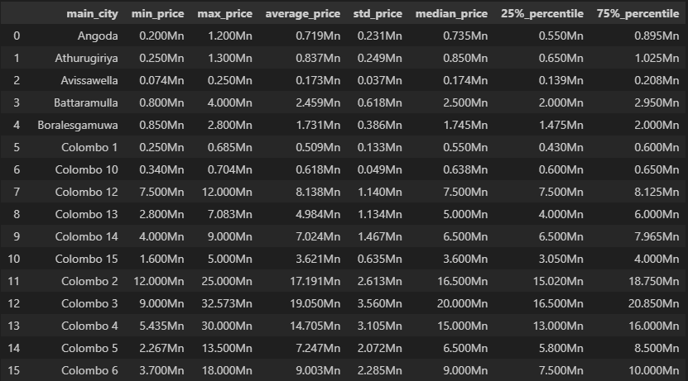
04. Results & Discussion
Exploratory Data Analysis
Computed minimum price, maximum price, average price, standard deviation, median price, 25th percentile and 75th percentile per each city

Slide 25
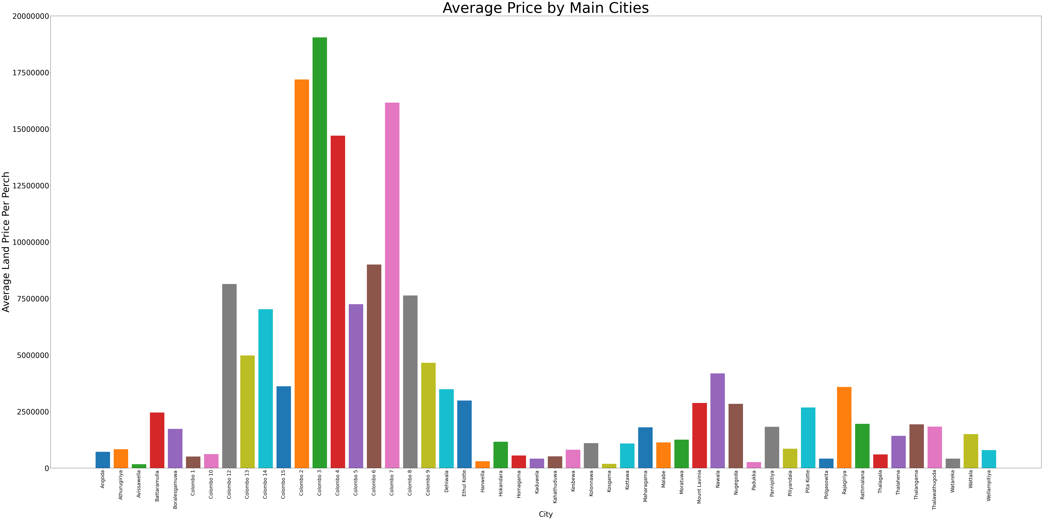
04. Results & Discussion
Exploratory Data Analysis
Overall Average price per city

Slide 26
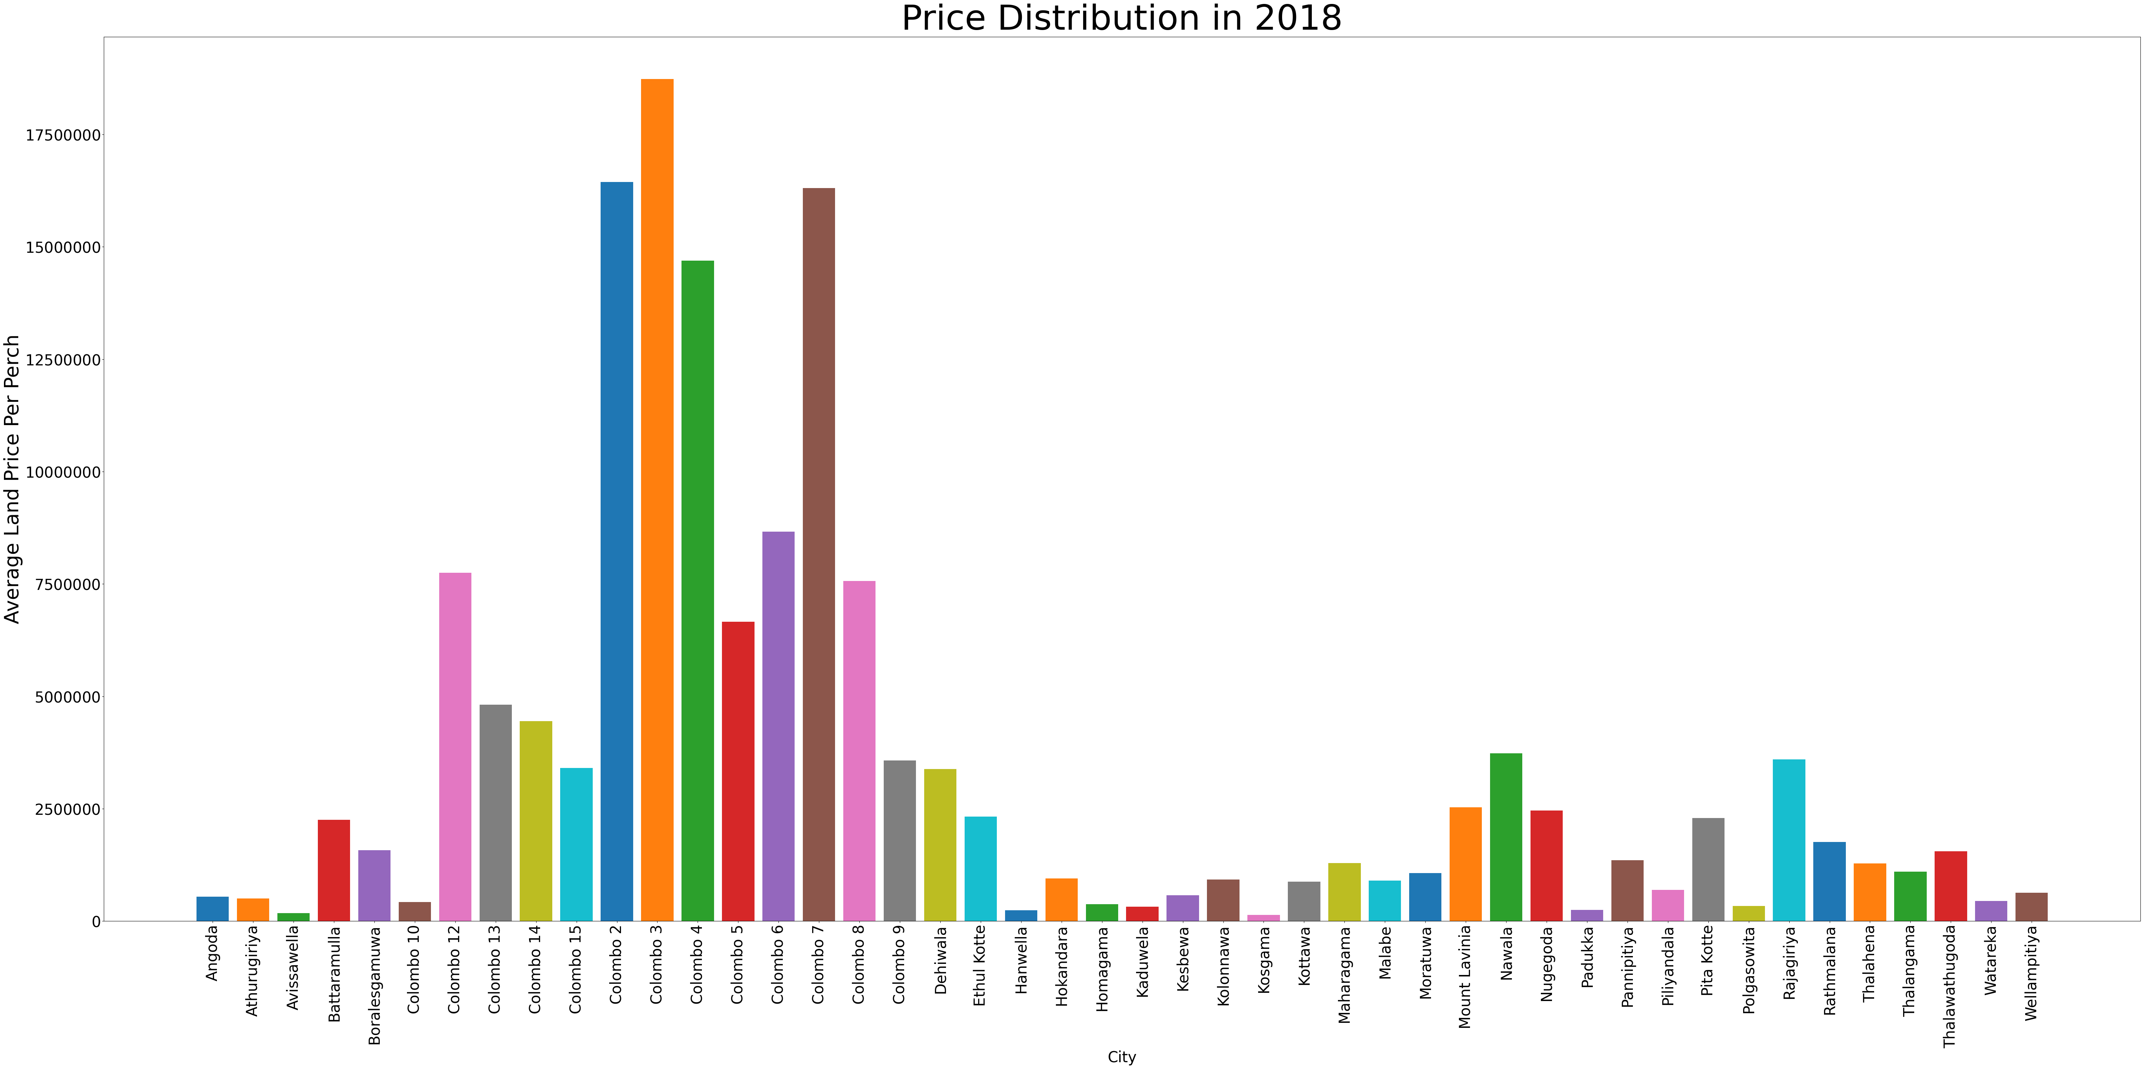
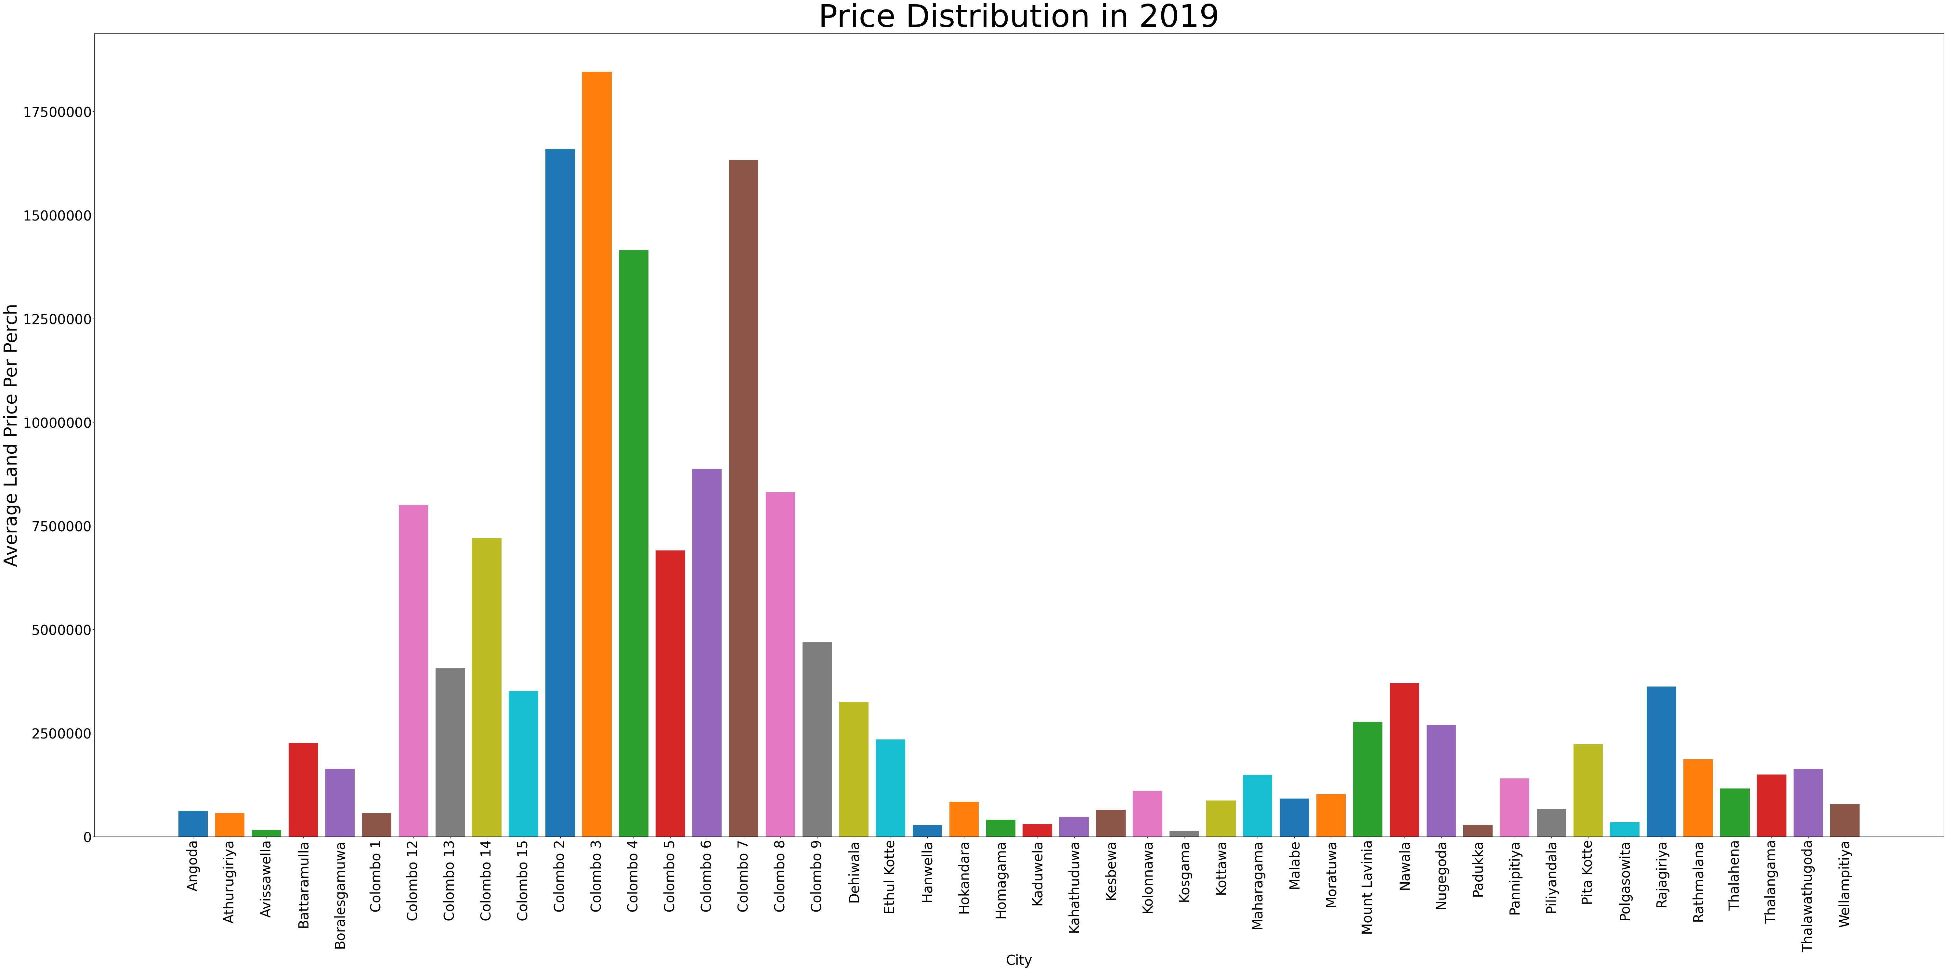
04. Results & Discussion
Exploratory Data Analysis
Average price per city in 2018
Average price per city in 2019

Slide 27
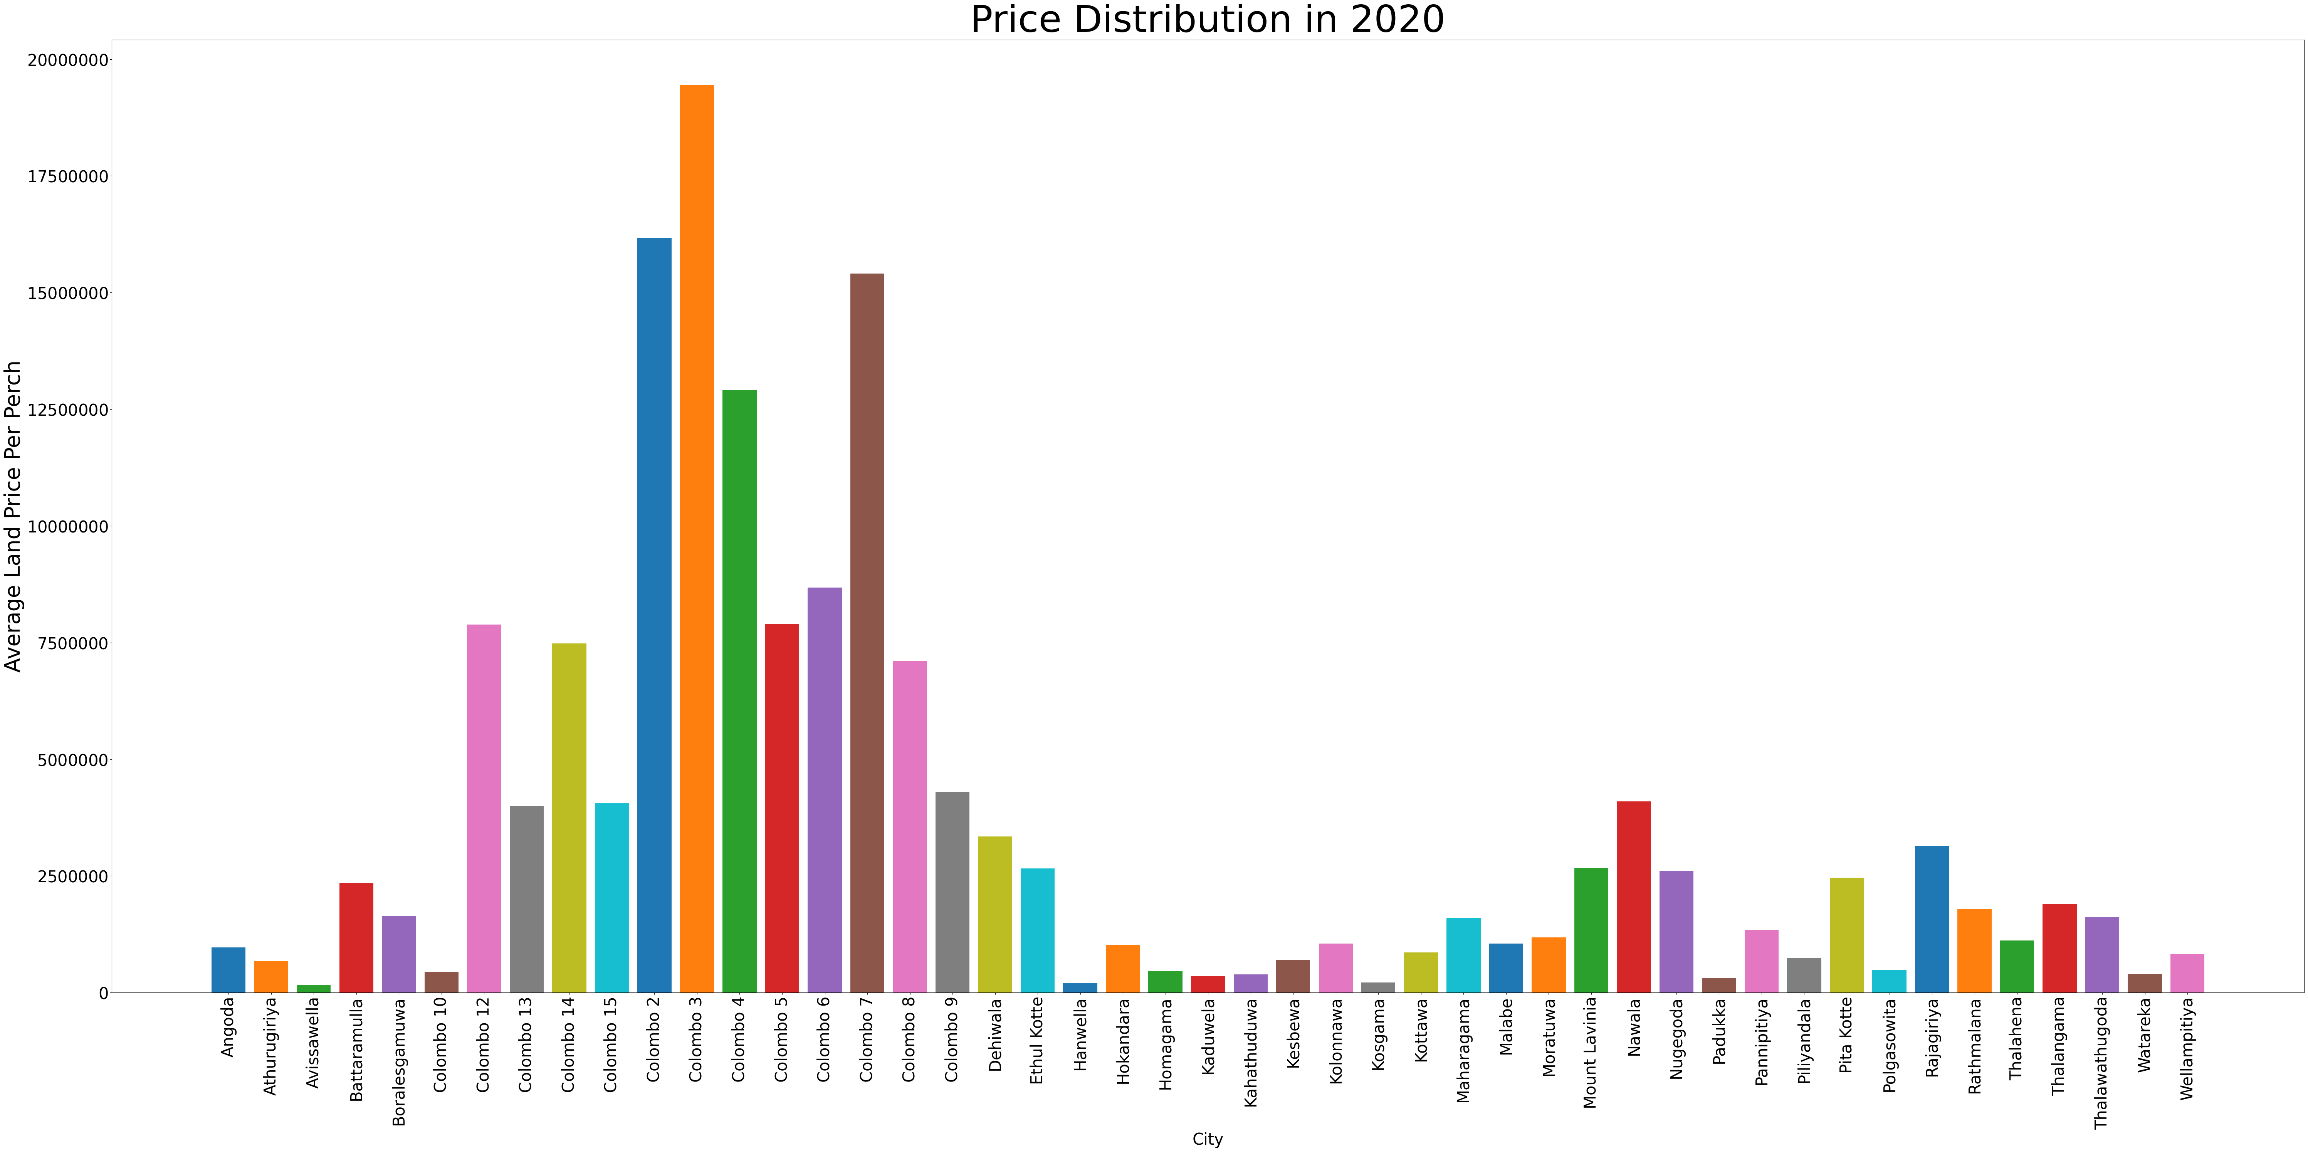
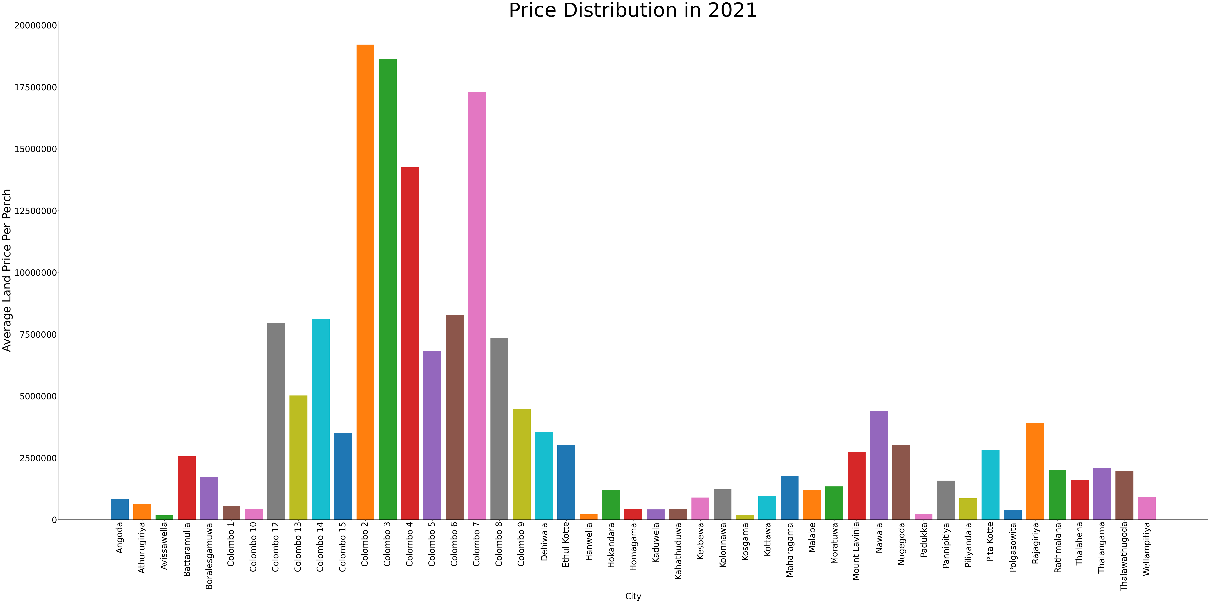
04. Results & Discussion
Exploratory Data Analysis
Average price per city in 2020
Average price per city in 2021

Slide 28
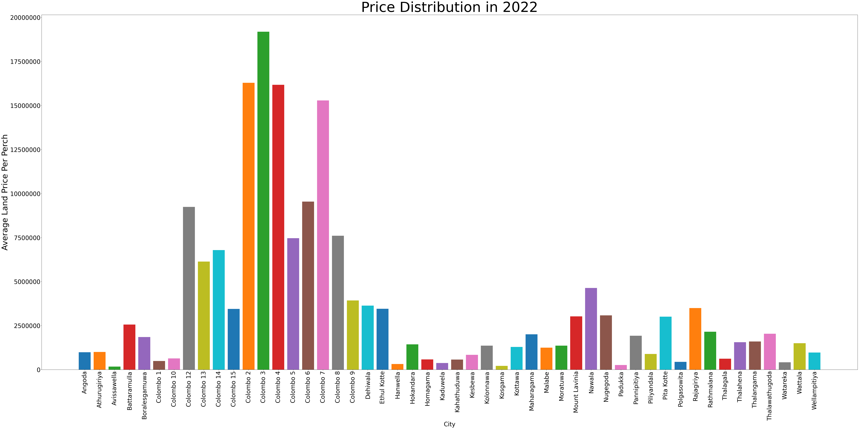
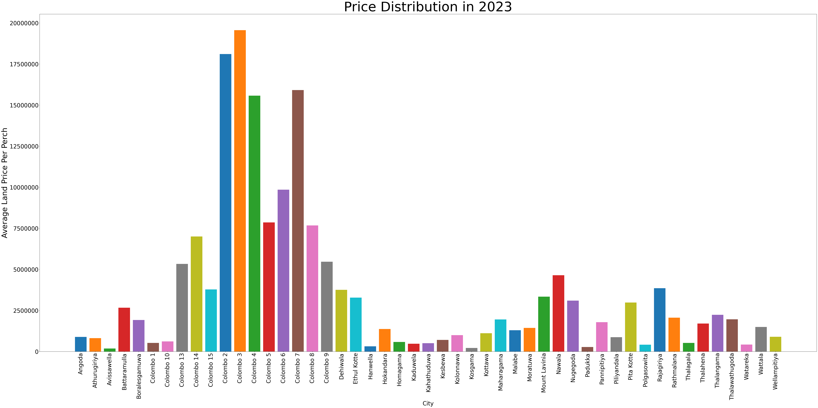
04. Results & Discussion
Exploratory Data Analysis
Average price per city in 2022
Average price per city in 2023

Slide 29
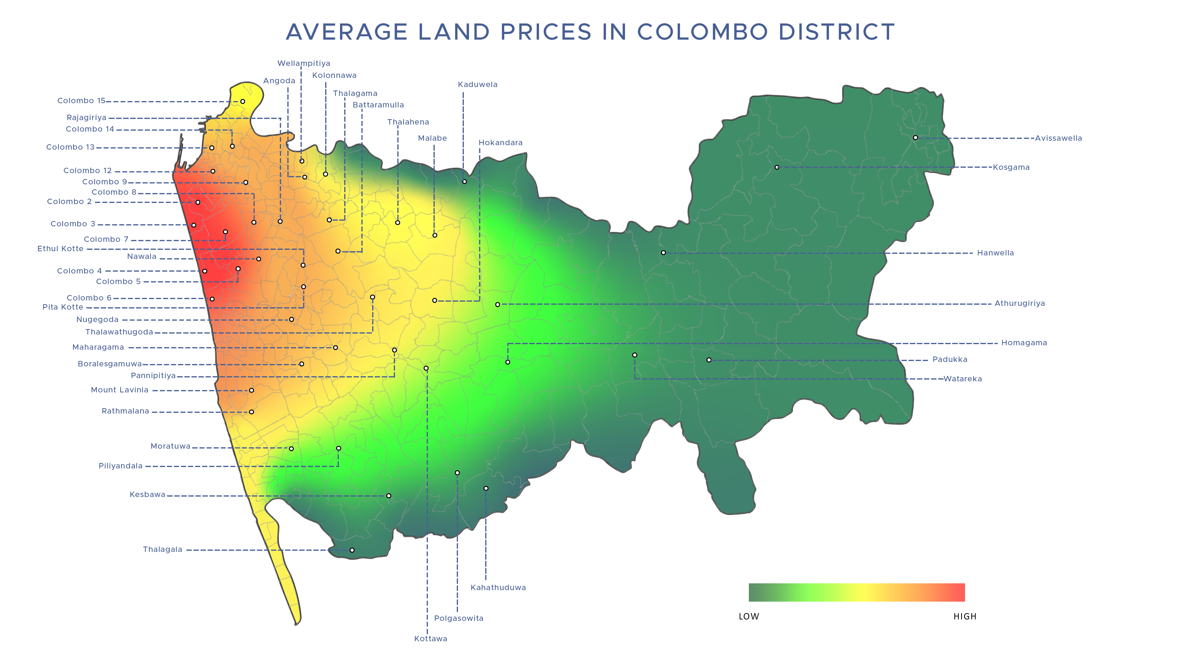
04. Results & Discussion
Exploratory Data Analysis
Average price visualization

Slide 30
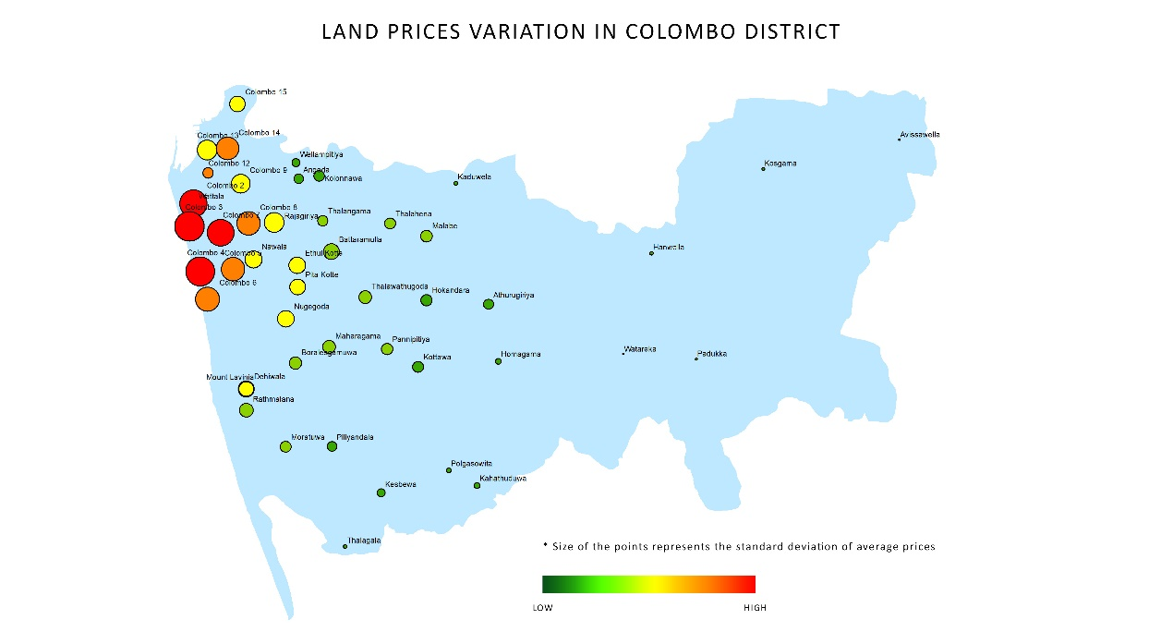
04. Results & Discussion
Exploratory Data Analysis
Average price with standard deviation

Slide 31
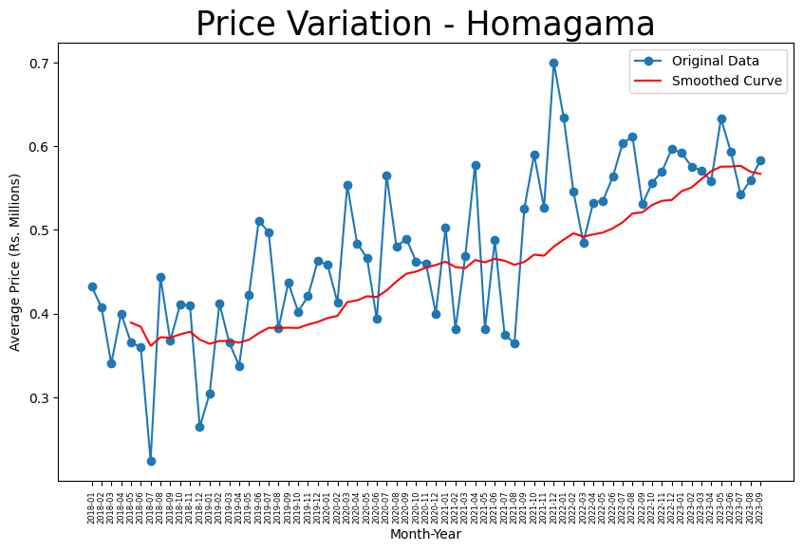
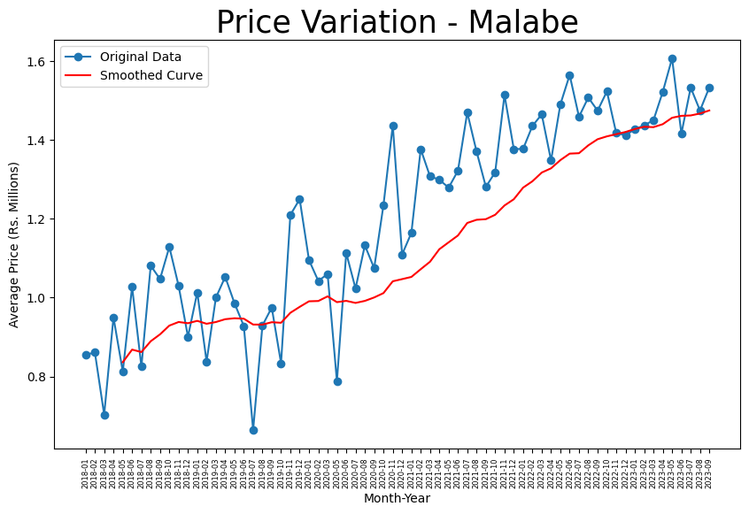
04. Results & Discussion
Time Series Analysis
Time Series analysis for land price per each city

Slide 32
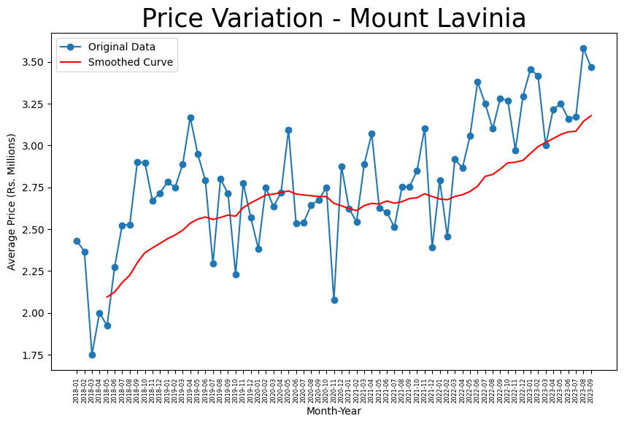
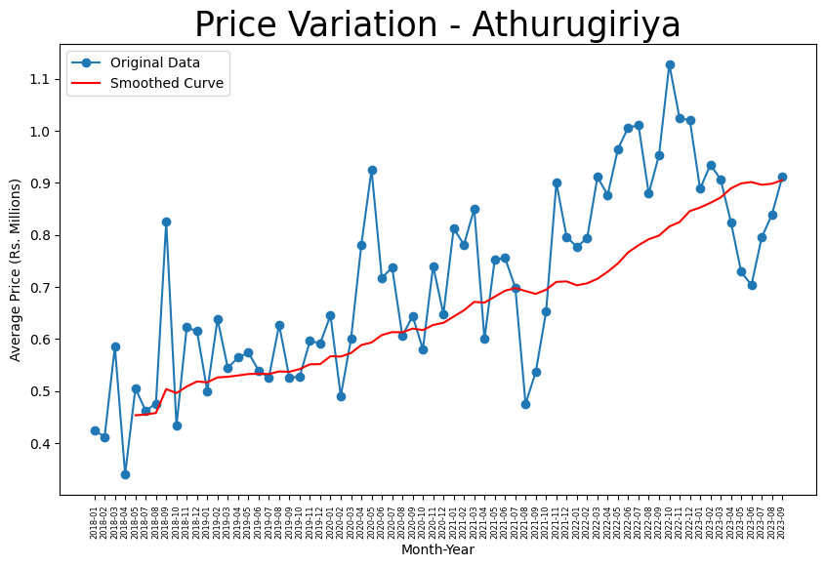
04. Results & Discussion
Time Series Analysis
Time Series analysis for land price per each city

Slide 33
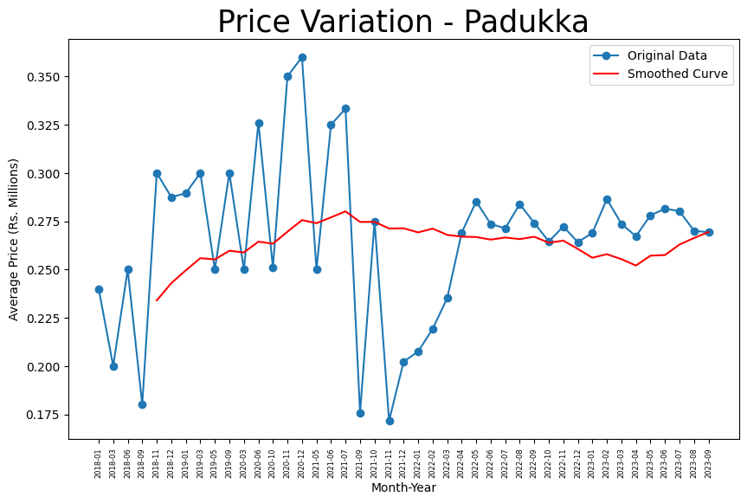
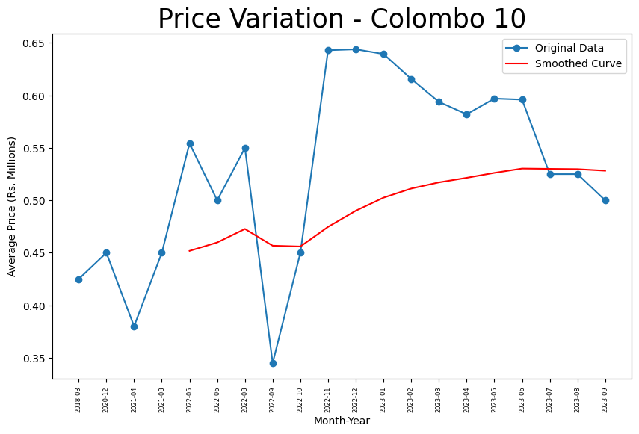
04. Results & Discussion
Time Series Analysis
Time Series analysis for land price per each city

Slide 34
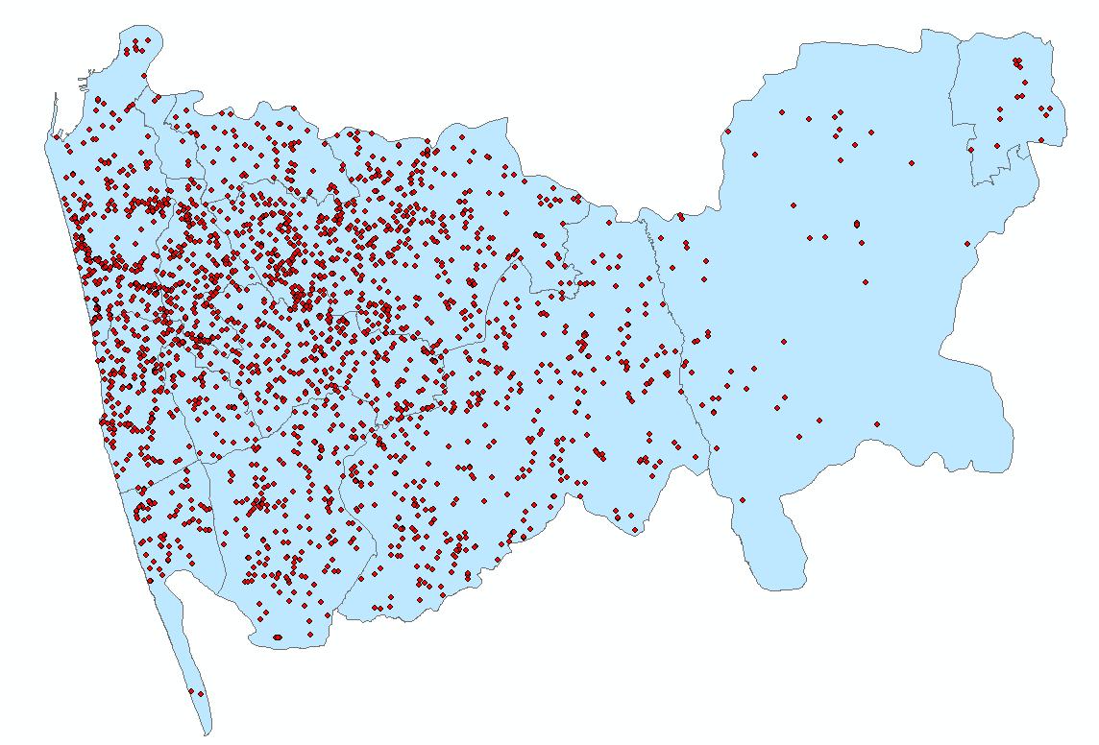
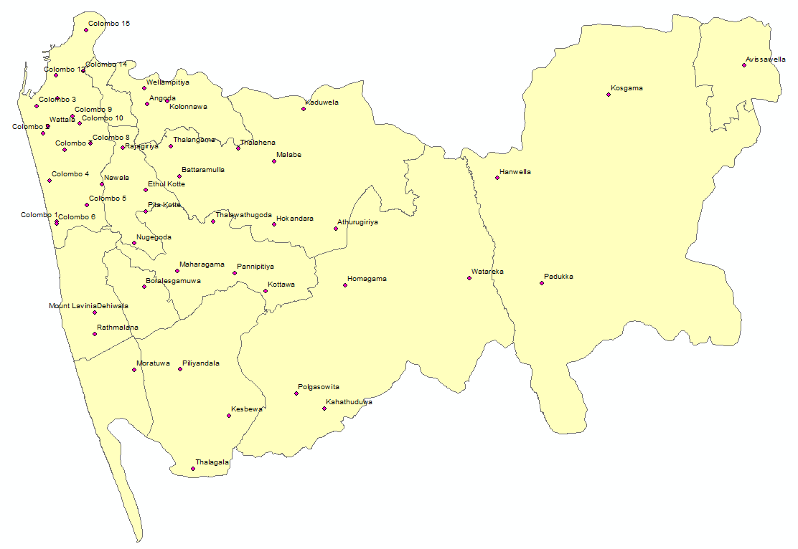
04. Results & Discussion
Spatial Network Analysis
Map of the lands in exact locations
Selected City centers

Slide 35
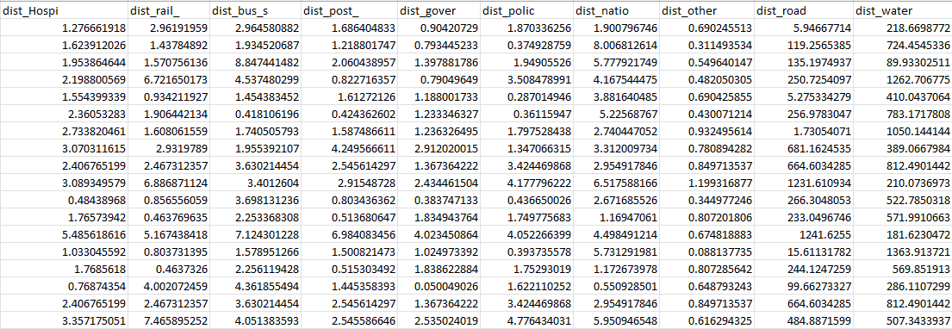
04. Results & Discussion
Spatial Network Analysis
Distances to special places from lands (Schools, Hospitals, Bus Stop, Railway Station, Police Station, Water Stream, Post office, Government office)

Slide 36
04. Results & Discussion
Machine Learning Model Building
Dataset finalized for model building consists of 8 variables with Variables obtained from spatial data.
Advertisement posted date
Main city
Land price per perch
Distance to nearest hospital
Distance to nearest school
Distance to nearest railway
Distance to nearest bus stop
Distance to nearest main road

Slide 37
04. Results & Discussion
Machine Learning Model Building
Excluded advertisement posted date for Machine Learning model building.
Five machine learning models constructed:
RandomForestRegressor()
GradientBoostingRegressor()
LinearRegression()
XGBRegressor()
Artificial Neural Network Models
Slight correlation observed among numerical variables.
Variable 'price_land_pp' exhibits low negative correlation with other variables, suggesting land prices decrease with increasing distance from those locations.

Slide 38
04. Results & Discussion
Machine Learning Model Building
Tuned Hyperparameters
Random Forest Regressor:
Number of estimators: 100
Max depth: None
Gradient Boosting Regressor:
Learning rate: 0.2
Number of estimators: 50
XG Boosting Regressor:
Learning rate: 0.1
Number of estimators: 50
Artificial Neural Network:
Two hidden layers with sizes 64 and 32
Output layer with 'relu' output function.
Tuned model alpha: 0.001
Maximum iterations: 10000

Slide 39
04. Results & Discussion
Machine Learning Model Building
Model Accuracies Summary
Model Name | Training Accuracy | Testing Accuracy
Linear Regression | 15.62% | 8.29%
Artificial Neural Network | 76.23% | 48.01%
Random Forest | 90.26% | 58.54%
Gradient boost | 88.48% | 60.01%
XG boost | 91.38% | 62.23%

Slide 40
04. Results & Discussion
Time Series Model Building
Built a time series forecasting model using SARIMA on dataset
Cutoff date set at '2023-09-01', records earlier than this date used for training.
User prompted to input main city, dataset filtered accordingly.
SARIMA model:
Lag observations set at 1 for autoregressive order.
Differencing for stationarity set at first-order.
Moving average window order specified as 1.
Seasonal period defined as 4 quarters.
Forecast land prices per perch from '2024' to '2027'.

Slide 41
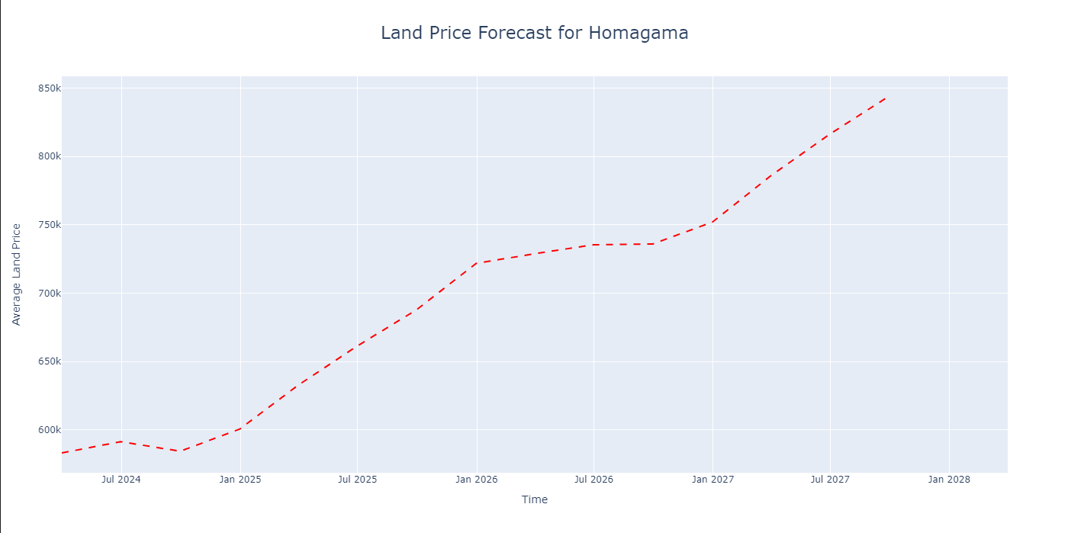
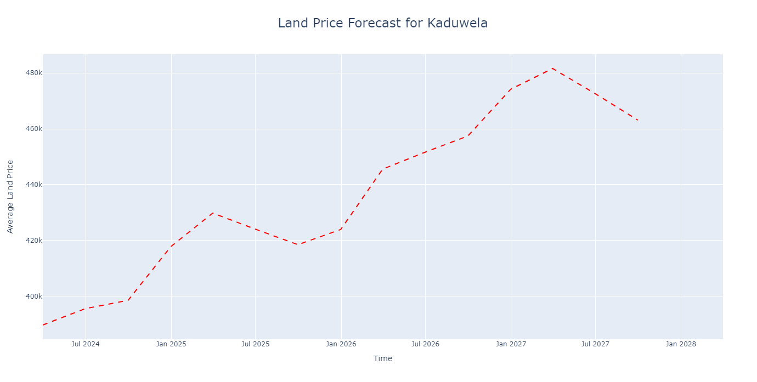
04. Results & Discussion
Time Series Model Building
Example Time Series Forecasting Plots

Slide 42
Data Cleaning & Preprocessing
Exploratory Data Analysis
Time Series Analysis
Spatial Network Analysis
Price Prediction Model Building
Time Series Model Building
Dashboard Creation

Slide 43
05
Conclusion & Future Works

Slide 44
05. Conclusion & Future Works
Conclusion
XG Boost has the highest accuracy (62.23%) among all models.
Final product of this study is a User-friendly dashboard as a valuable resource for land transaction stakeholders
https://landpriceforecastingapp-sbfssfrle7epsae42m7xxo.streamlit.app/
Future Works
Potential to expand model development to all districts in Sri Lanka
Consideration of district-specific variables for higher accuracy (e.g., altitude in Kandy district)
Possibility to drill down to smaller location levels (e.g., street level)

Slide 45
05. Conclusion & Future Works
Challenges
Solutions
Lack of data after cleaning | Dataset Changed. Then redone the preprocessing part
Many incorrect data were in the dataset | Had to use a method used by the company by their experience to remove outlier prices
Land locations were not correctly placed | Had to visualize and remove the datapoints out of Colombo
There is no any city wise shape file in the Survey Department to buy | Had to use alternative visualization methods to visualize city wise data

Slide 46
06
Acknowledgement

Slide 47
06. Acknowledgement
I extend my heartfelt gratitude to Prof. Roshan D. Yapa, my internal supervisor, whose expertise and encouragement were invaluable throughout this project. Special thanks to my external supervisors, Mr. Chamara Thewarapperuma & Mr. Tharindu Jayarathne at ‘Lanka Property Web’ for their guidance, enriching the project with real-world insights. I would also like to acknowledge the all-staff members of the Statistics and Computer Science Department for any support the given. Additionally, my appreciation goes to the dedicated professionals at ‘Lanka Property Web’ for their cooperation and assistance, with experience over the years contributing significantly to the project's development. This collaborative effort from all parties involved has played a pivotal role in the successful completion of this project.

Slide 48
Thank You!

